Slide 1
Eenie Meenie Miney Macro
Tips on When to Use Which Macro Type
Jarrod Thuener
May 2021

Slide 2
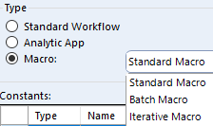
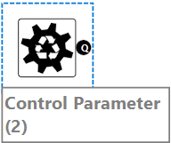
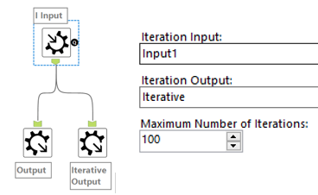
What are the types of Macros?
Standard Macro is any reusable set of tools
any number of inputs/outputs
can use interface tools for updating variables
can map to incoming fields
Batch Macro – reusable set of tools that run 1 time for each parameter passed through
Iterative Macro – reusable set of tools that run iterations until it runs out of records.
Notes:
Batch macros = “For Loop”
Iterative Macro = “while Loop”

Slide 3
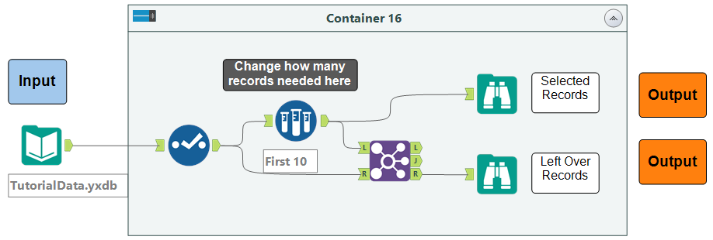
Standard Macro
In Workflow (Container is “Macro”)
Notes:
Pretty straight forward macro of sampling the first set of records and returning the rest in a second output

Slide 4
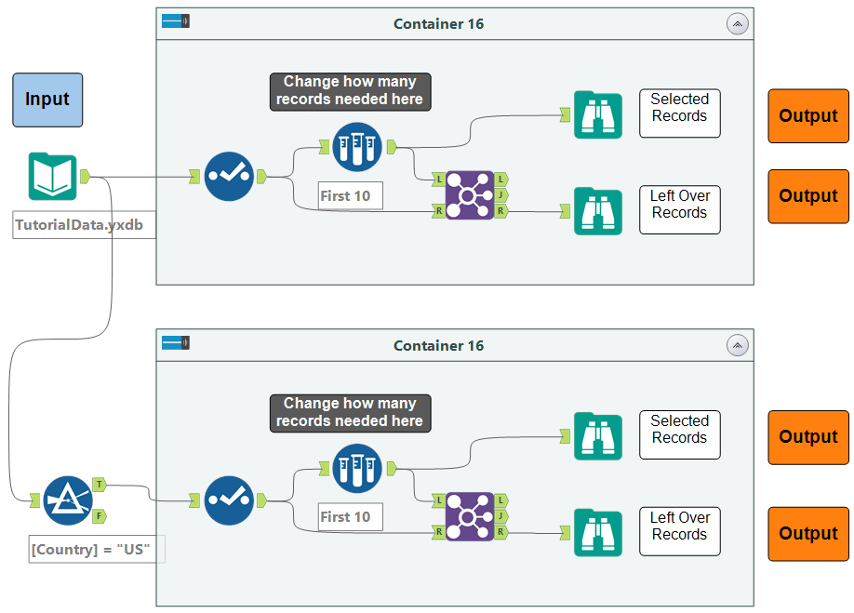
Standard Macro
In Workflow (Container is “Macro”) - Copy/Paste to reuse – Change sample manually
Notes:
Need to manually change the sample Data number for each version copied.

Slide 5
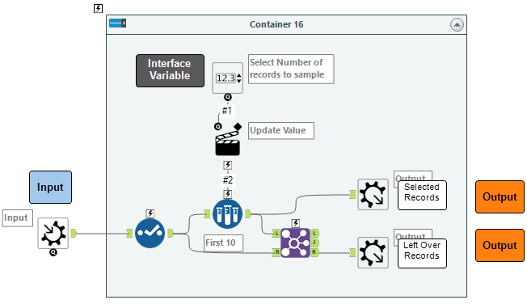
Standard Macro
As a Macro
Notes:
The Numeric Up Down tool allows the user to change the number of records to sample. Note that the input and output labels now have macro input/output tools.

Slide 6
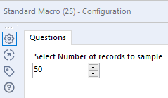
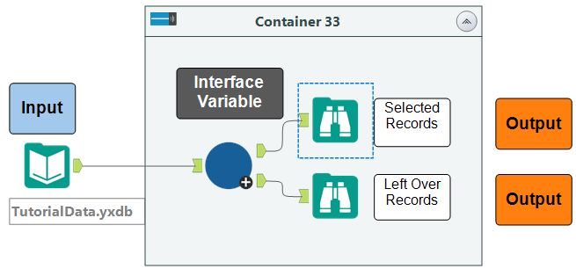
Standard Macro
Macro Within the workflow
Notes:
Number of records to sample is controlled in the macro. The entire process is conducted in the blue macro.

Slide 7
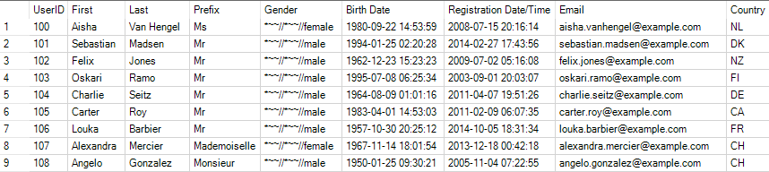
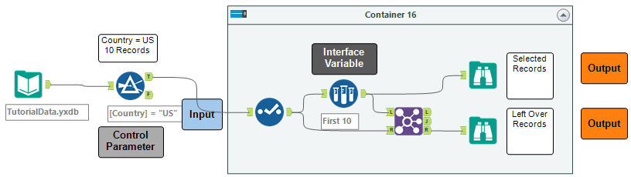
Batch Macro – Group By Problem
Scenario: We want to pull different number of records per country.
Notes:
Here, we want to pull a set number of records for country = US

Slide 8
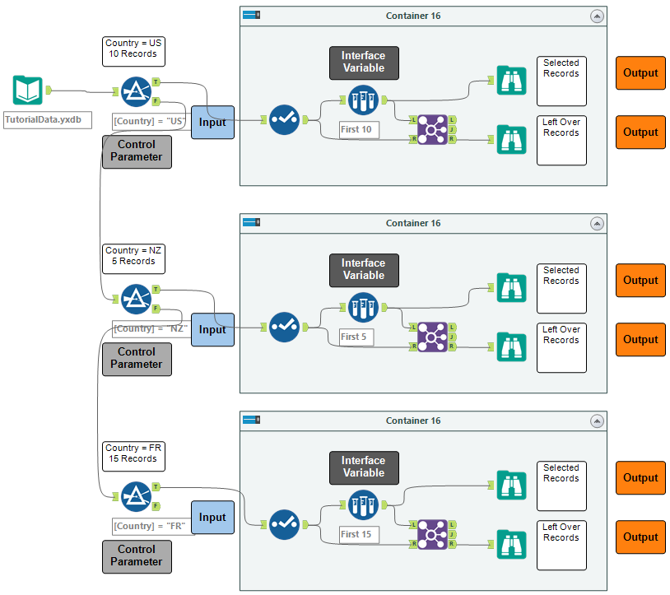
Batch Macro – Group By Problem
In Workflow – Copy and change sample size for each country
Notes:
Changing the Sample Size would typically be an interface variable like in our standard macro, but we want to change the number for each country available.

Slide 9
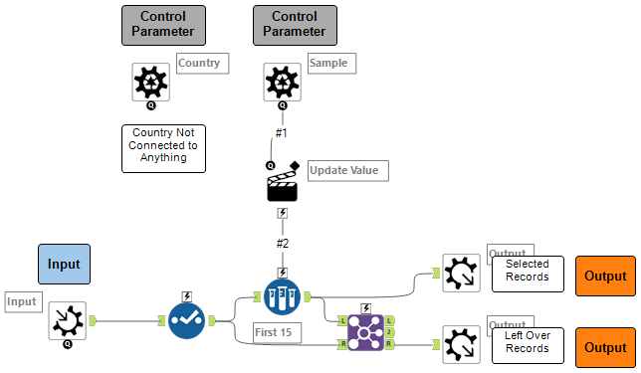
Batch Macro – Group By Problem
As a Macro
Notes:
Two control parameters are used here
Country – We’ll use this to group records later.
Sample – we’ll pass through the number of records per country. This replaces the Numeric Up Down tool.

Slide 10
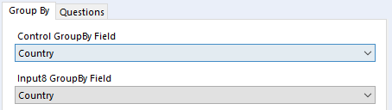
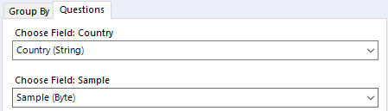
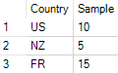
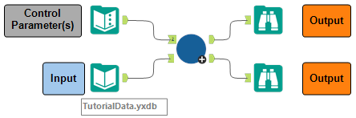
Batch Macro – Group By Problem
Macro within the workflow – Group by Country and Map the input fields
Notes:
Connect the country/Sample table to the control parameter anchor (upside down question mark)
In macro settings, group by Country fields – it basically filters the data before running each record.
In the questions tab, just map the input data.

Slide 11
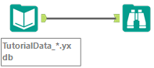
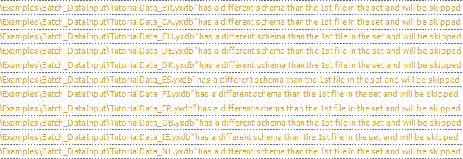
Batch Macro – Multi-Field Problem
Scenario: We can’t pull in many files using a wildcard due to different schemas.
Notes:
Here, we have the “different schema” warning while pulling in a list of files using the wildcard.

Slide 12
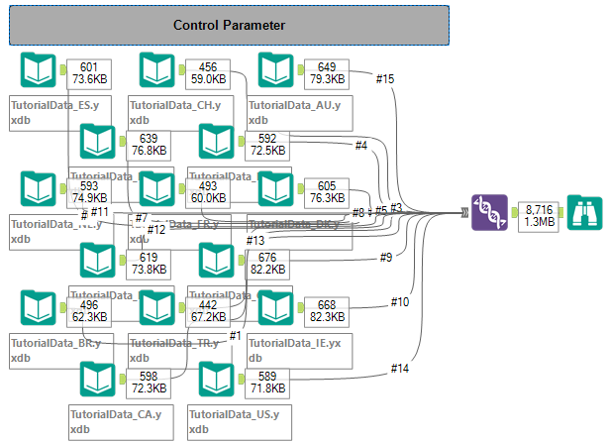
Batch Macro – Multi-Field Problem
In Workflow – Drag all files
Notes:
Here, we have all of the files manually dragged and dropped onto the canvas then connected to the union tool.
We usually won’t have all the files in a single location or there could be thousands of files.

Slide 13
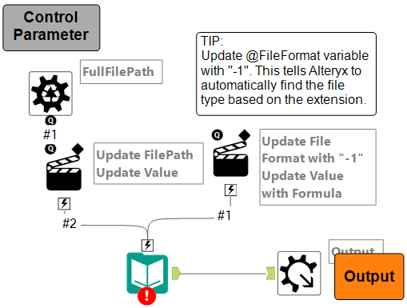
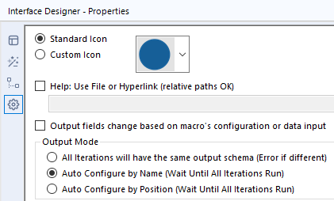
Batch Macro – Multi-Field Problem
As a Macro
Notes:
Update full file path using a control parameter.
Set File Format to “-1” – it forces alteryx to find the correct file type by using the extension.
In the Interface Designer properties, set the output mode to “auto configure by name” – this acts as a union tool configured by name.

Slide 14
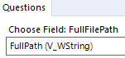
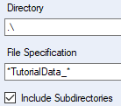
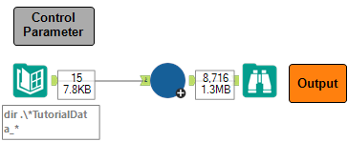
Batch Macro – Multi-Field Problem
Macro within the workflow – Find all files using directory tool and Map the FullPath field
VS
Notes:
Find all files (regardless of directory) by using the directory tool, (union if you have too), then you can just map the full path to the macro control parameter input.

Slide 15
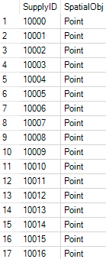
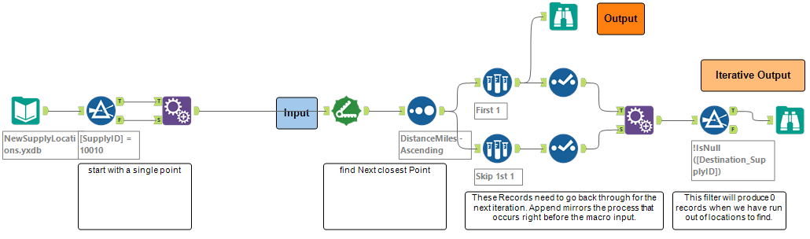
Iterative Macro – Next Closest Location
Scenario: We have a list of locations and need to find the order in which to visit
Notes:
Let’s find the order of locations to visit.

Slide 16
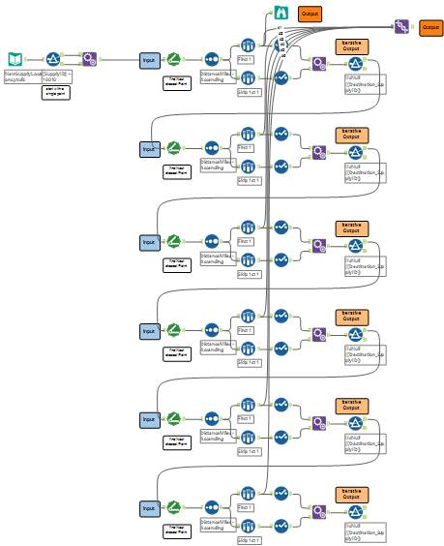
Iterative Macro – Next Closest Location
In Workflow – copy end-to-end for each location to find “Next” stop
Notes:
Connect the data from Distance tool to Filter tool end to end until we find our complete location order. This could be 100’s or 1000’s of times….

Slide 17
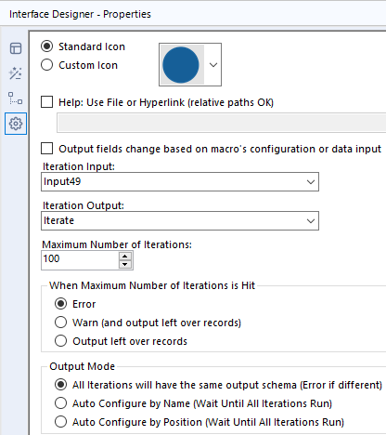
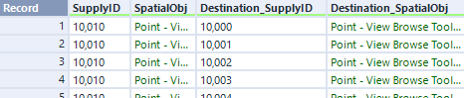
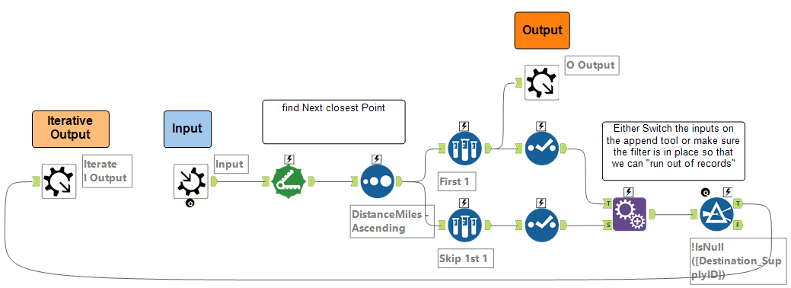
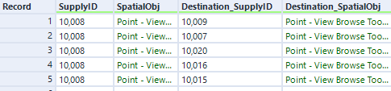
Iterative Macro – Next Closest Location
As a Macro
Notes:
Note the colors of the labels and that we are finding the next location, which then becomes our origin for the next “Iteration”
I only dragged the iterative output macro tool to the front of the process because visually, that is what is happening.
Make sure to set the input and output macro tools in the Interface designer.

Slide 18
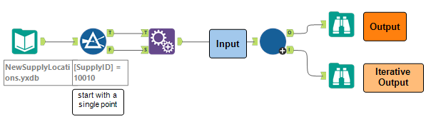
Iterative Macro – Next Closest Location
Macro within the workflow – Find all files using directory tool and Map the FullPath field
VS
Notes:
This macro will run as many times as we have locations to figure out the full list, in order.

Slide 19
Summary – When to use
Standard Macro
Batch Macro
Iterative Macro
Typically used when you have a process that can be applied to different fields but need to “re-map” to get it to work.
Need same set of tools in another workflow or somewhere else in the same workflow
Minor tweaks to settings – all records treated the same
Have a list of “versions” you want to run through a set process
You know the number of times you need to run (list of variables)
You want to modify a variable dynamically that isn’t controlled by “Input Connector”
Using “group by” function in a set of tools
Need to run a process several times in a row on the same dataset
You don’t know the number of times needed to run
Each “iteration” is dependent on the previous run’s output
Running API “paging” calls

Slide 20
Macro Usage Tips
Build a process and keep contained in a tool container. If you like the format of data coming in and going out, then you can copy out that container and save as a macro.
Start with the general workflow then add actions to the tools for customization.
Batch Macros – use “group by” option to auto-filter the input data stream.
Iterative macros – make sure the output macro tool that you are going to pass back to the input has the same fields and types as the macro input tool. **Use a union to check.**

Slide 21
Additional Resources
This Presentation With Demos
https://github.com/jarrodthuener/Alteryx-Inspire-2021
Weekly Challenges
https://community.alteryx.com/t5/Weekly-Challenge/bd-p/weeklychallenge
Macro Trainings
https://community.alteryx.com/t5/Videos/Build-Your-First-Iterative-Macro/td-p/55565
https://community.alteryx.com/t5/Videos/Advanced-Macro-Development/td-p/43862
https://community.alteryx.com/t5/Videos/Build-Your-First-Batch-Macro/td-p/52900

Slide 22


Now Please Join Us For A Short Survey
Notes:
Remember to click on the “Survey” button and locate the survey that matches this session’s title to provide feedback.
It should take you less than a minute to complete the survey.

Slide 23

See what Alteryx can do for you. Download a free trial of Alteryx today. alteryx.com/trial
Jarrod Thuener
@Jarrod on community @jarrodthuener on Twitter

